Slide 1
Wandsworth is London Borough of Culture 2025

Slide 2
What is Welcome to Wandsworth
Welcome to a joyful year where every corner of the borough comes alive in an explosion of creativity. From Roehampton to Battersea, Tooting to Putney, we are preparing to stage a spectacular year.
Our cultural programme is being created with local people and organisations, with events for everyone. From a mass dance event to a choral spectacular, we will come together to share experiences. By connecting us, our year can supercharge our health and happiness. It will open doors for our residents and help people find creative careers. We want it to be a catalyst for change so that creativity is recognised for its power to improve our health.
Wandsworth’s London Borough of Culture year will begin in April 2025 and run until March 2026. The programme launch will be in early 2025.

Slide 3
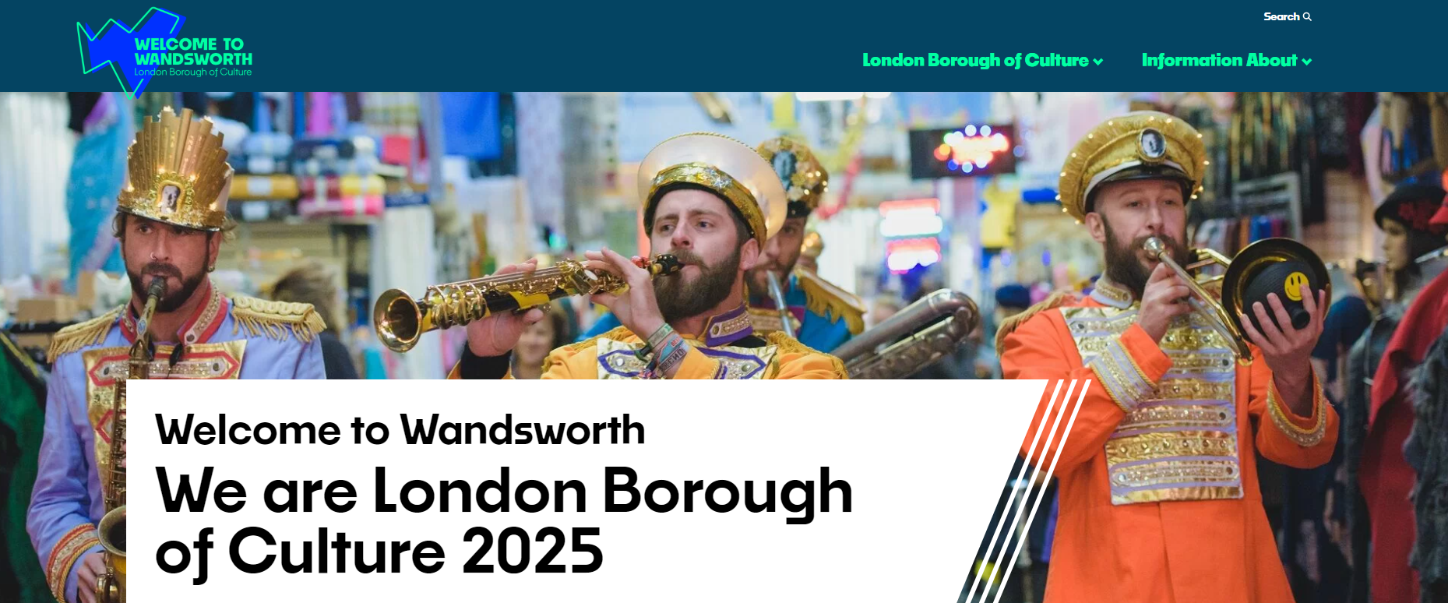
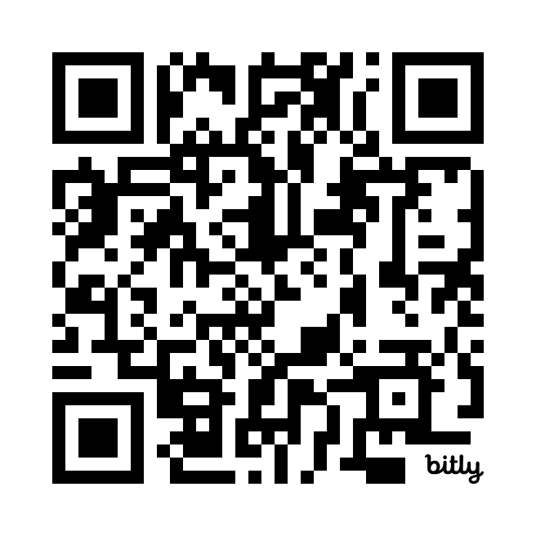
A brand new website
welcometowandsworth.com
From early 2025, you can:
Set Up a Creative Profile - Are you a Wandsworth-based creative or organisation? Set up a creative profile on our website.
Register Your Event- Planning a cultural event in Wandsworth between April 2025 and March 2026? Submit it to be part of our What’s On calendar.
Follow us:
FB & IG: @welcometowandsworth
X/TW: @wtowandsworth

Slide 4
London Borough of Culture Community Investment Grants
Open now:
Liberty Festival Research & Development (R&D) artistic commissions: Up £10,000 to support d/Deaf, disabled and neurodivergent artists. Closes 8 January 2025.
Liberty Festival Participatory R&D grants: Up to £1,500 to support disability organisations in experimenting and sharing new ways of working, collaborating and advocating for the sector through artistic collaboration. Closes 8 January 2025.
Coming soon:
Microgrants: Grants of up to £1,000 will be available to support the development of new work. Grants will be awarded on a monthly, rolling basis from early 2025.
Grants: Grants of between £2,000 and £10,000 will be open to applications to support work as part of our London Borough of Culture programme. Opening in January and May 2025.
Black History 365 and South Asian Heritage Month Grants: Grant funding will be open to applications for work as part of Black History 365 or South Asian Heritage Month.

Slide 5
Wandsworth Arts Fringe
6 – 22 June 2025
Wandsworth Arts Fringe is a proudly inclusive, open access arts festival.
This year the festival will be a pivotal part of Wandsworth’s London Borough of Culture year.
Expressions of interest close: 12 Dec 2024.
Registrations open: 12 Dec 2024 – 14 Feb 2025.

Slide 6
London Borough of Culture Volunteering Programme
Look out for our Volunteering Programme coming in early 2025.
When it is live, we’ll be back in touch as we’d love to have your support in getting all of our volunteering opportunities out to the community!
If you are seeking volunteers for your creative programme, we would also love to promote these opportunities on our website in the new year.

Slide 7
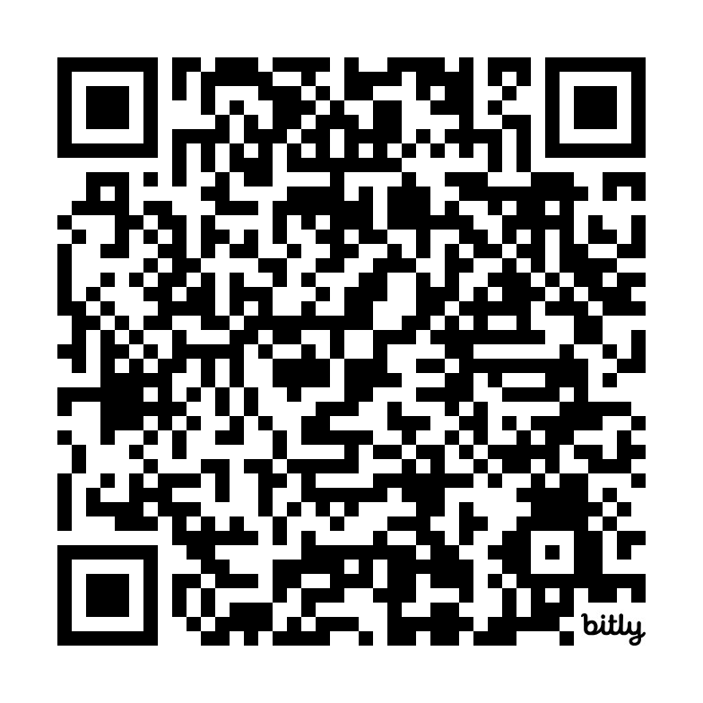
Sign up to our Creative Industries mailing list

